Slide 1




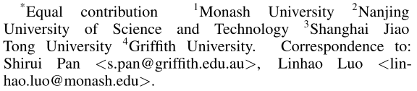





ATAI
Advanced Technique of Artificial Intelligence
ATAI
ChongqingUniversity _{AdvancedTechniqueof}
of Technology Artificial Intelligence
Chongqing University of
Technology
Chongqing University ^{ATAI}
_{of Technology} Advanced Techniqueof
Artificial Intelligence
Chongqing University of Technology
Chongqing University of Technology
Graph-constrained Reasoning: Faithful Reasoning on Knowledge Graphs with Large Language Models
Code:https://github.com/RManLuo/graph-constrained-reasoning
——ICML_2025
Reported by Long Zhang

Slide 2
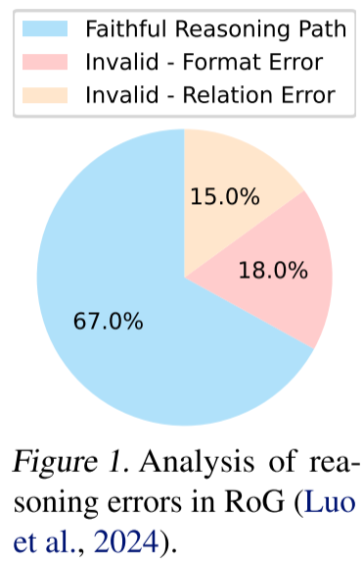
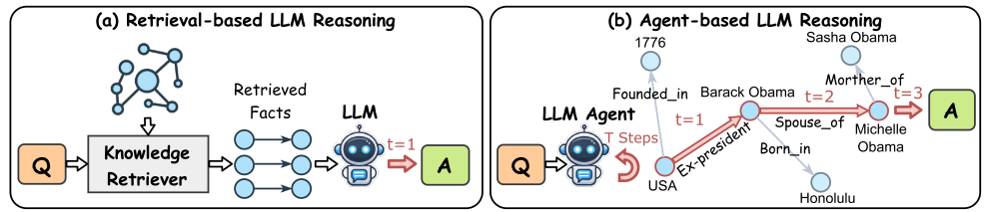
ATAI
Advanced Technique of Artificial Intelligence
ATAI
ChongqingUniversity _{AdvancedTechniqueof}
of Technology Artificial Intelligence
Chongqing University of
Technology
Chongqing University ^{ATAI}
_{of Technology} Advanced Techniqueof
Artificial Intelligence
Chongqing University of Technology
Chongqing University of Technology
Motivation
1) LLMs are prone to factual errors ( illusions ) and unfaithful reasoning paths in reasoning, especially when relying on structured knowledge.
2) The efficiency bottleneck of the existing KG enhanced LLM method:
(a) Retrieval-based paradigms: It is difficult to capture the KG structure, the retrieval accuracy is insufficient, and the generalization is poor.
(b) Agent-based paradigms: It requires multiple rounds of interaction, high computational cost and large delay.

Slide 3
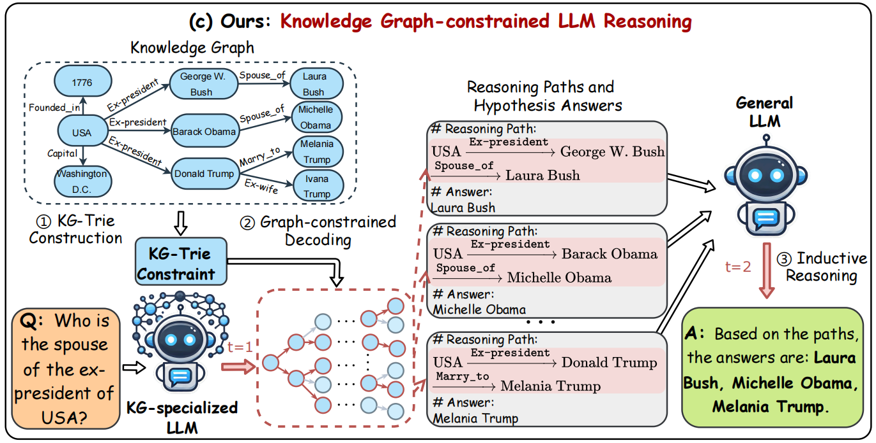
ATAI
Advanced Technique of Artificial Intelligence
ATAI
ChongqingUniversity _{AdvancedTechniqueof}
of Technology Artificial Intelligence
Chongqing University of
Technology
Chongqing University ^{ATAI}
_{of Technology} Advanced Techniqueof
Artificial Intelligence
Chongqing University of Technology
Chongqing University of Technology
Method

Slide 4
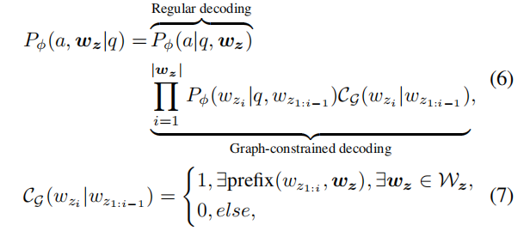
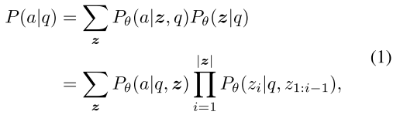

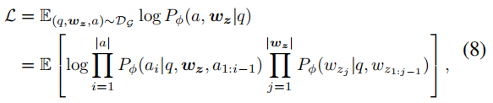
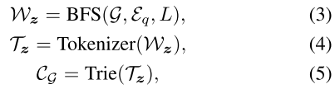
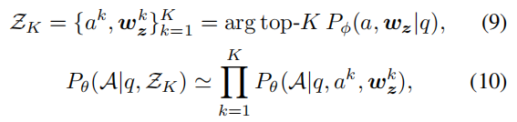
ATAI
Advanced Technique of Artificial Intelligence
ATAI
ChongqingUniversity _{AdvancedTechniqueof}
of Technology Artificial Intelligence
Chongqing University of
Technology
Chongqing University ^{ATAI}
_{of Technology} Advanced Techniqueof
Artificial Intelligence
Chongqing University of Technology
Chongqing University of Technology
Method

Slide 5
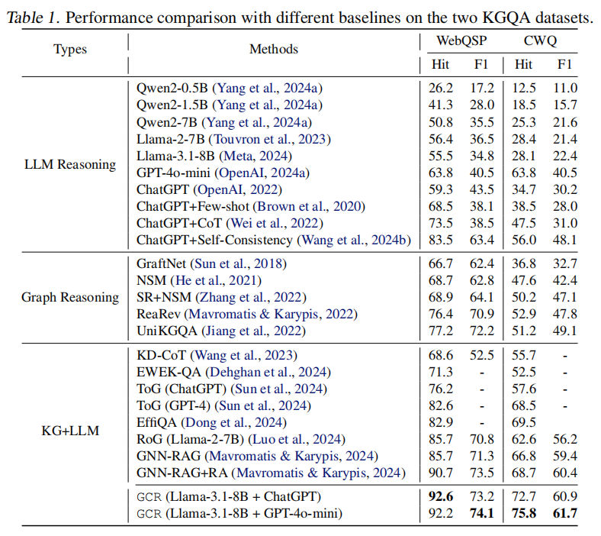
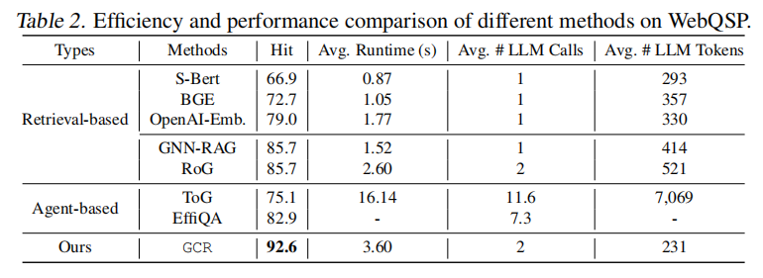
ATAI
Advanced Technique of Artificial Intelligence
ATAI
ChongqingUniversity _{AdvancedTechniqueof}
of Technology Artificial Intelligence
Chongqing University of
Technology
Chongqing University ^{ATAI}
_{of Technology} Advanced Techniqueof
Artificial Intelligence
Chongqing University of Technology
Chongqing University of Technology
Method

Slide 6
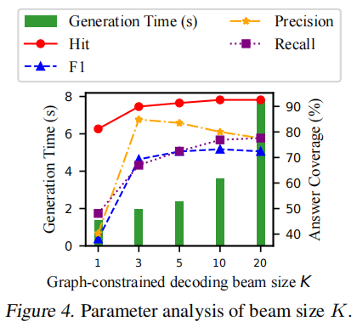
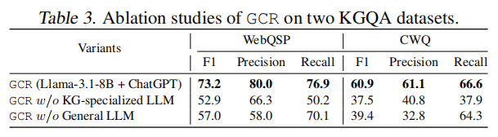
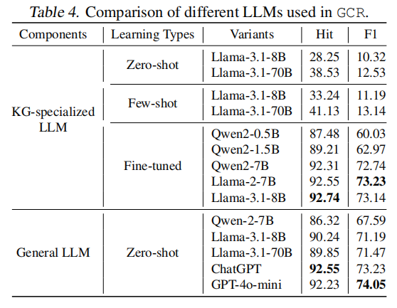
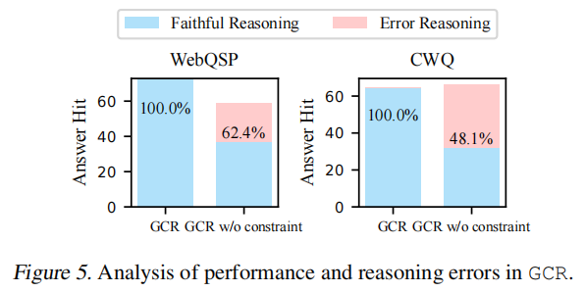
ATAI
Advanced Technique of Artificial Intelligence
ATAI
ChongqingUniversity _{AdvancedTechniqueof}
of Technology Artificial Intelligence
Chongqing University of
Technology
Chongqing University ^{ATAI}
_{of Technology} Advanced Techniqueof
Artificial Intelligence
Chongqing University of Technology
Chongqing University of Technology
Experiments

Slide 7
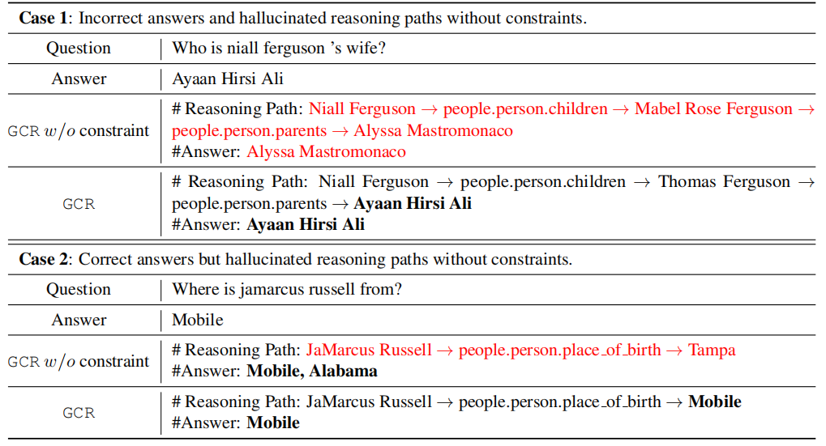
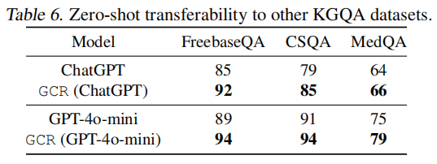
ATAI
Advanced Technique of Artificial Intelligence
ATAI
ChongqingUniversity _{AdvancedTechniqueof}
of Technology Artificial Intelligence
Chongqing University of
Technology
Chongqing University ^{ATAI}
_{of Technology} Advanced Techniqueof
Artificial Intelligence
Chongqing University of Technology
Chongqing University of Technology
Experiments

Slide 8


ATAI
Advanced Technique of Artificial Intelligence
ATAI
ChongqingUniversity _{AdvancedTechniqueof}
of Technology Artificial Intelligence
Chongqing University of
Technology
Chongqing University ^{ATAI}
_{of Technology} Advanced Techniqueof
Artificial Intelligence
Chongqing University of Technology
Chongqing University of Technology
Thanks!

